Slide 1
Image Analysis Algorithms for Crack Detection Using a Smartphone Mounted in a Car:
By: Akira DeMoss, Maggie Dalton, Modeste Kenne, and Nik Thota
Advisor: Halil Ceylan
Client: Bo Yang
Team Name: sdmay20-18
Website: http://sdmay20-18.sd.ece.iastate.edu/
Notes:
Akira DeMoss

Slide 2
Project Vision
Problem: Gathering data about cracks/potholes found in roads is time consuming and often dangerous
Who does this impact?: Researchers
Our Goal: Remove the need for researchers to leave their vehicles to gather data
How: Use a smartphone mounted in a vehicle to gather and classify data using machine learning algorithms
Notes:
Maggie

Slide 3
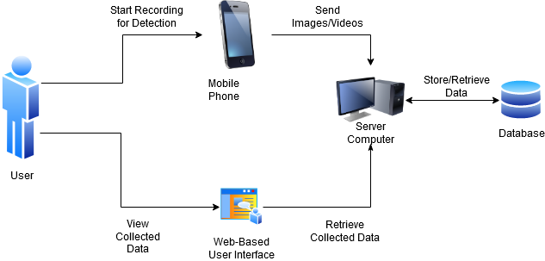
Conceptual Design Diagram
Notes:
Maggie

Slide 4
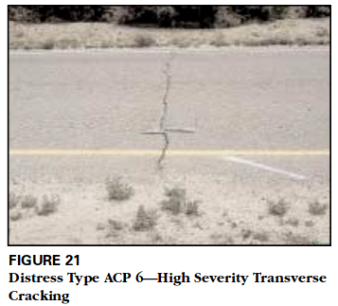
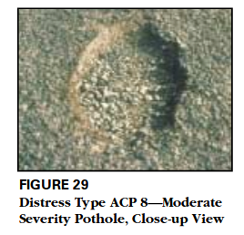
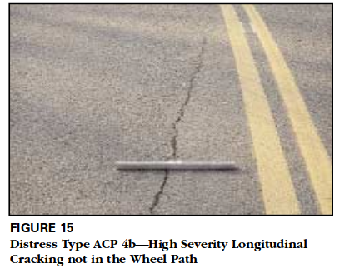
Requirements - Functional
Detect and classify longitudinal cracks, transverse cracks, and potholes
Save the location and images/videos of detected cracks or potholes
Require no additional interaction from the user after recording is initiated
Make the collected data available
Notes:
Maggie

Slide 5
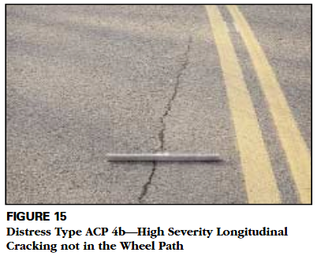
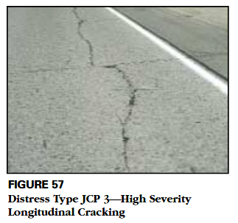
Requirements - Non-Functional
Be able to detect cracks/potholes on multiple road types
Be able to detect cracks/potholes at multiple speeds
Be able to detect and classify cracks/potholes in accordance to the Long-Term Pavement Performance Program (LTPP) distress manual
Asphalt Concrete-Surfaced Pavement
Jointed Concrete-Surfaced Pavement
Notes:
Maggie

Slide 6
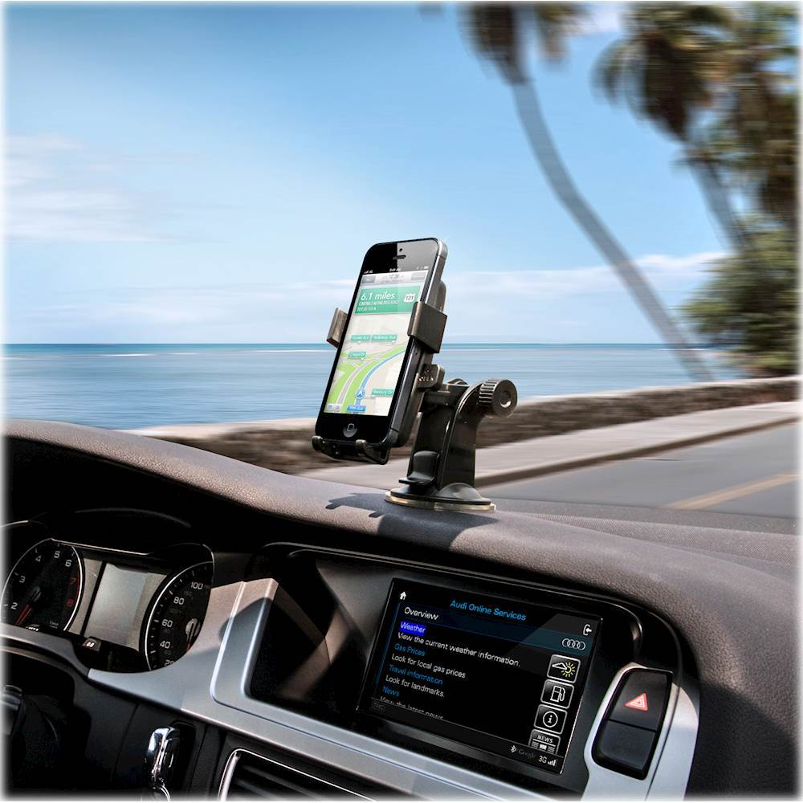
Constraints
App must be functional on a standard mobile device mounted in 3rd party car mount
Simple to use by researchers, no prior knowledge required
Classification criteria must match the LTPP distress manual
Notes:
Maggie
Technical or other constraints

Slide 7
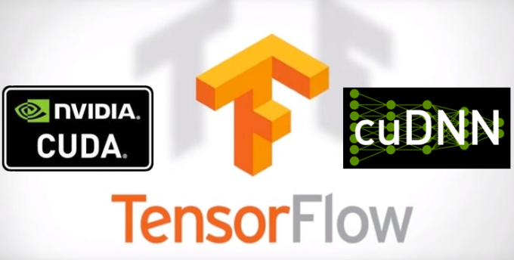
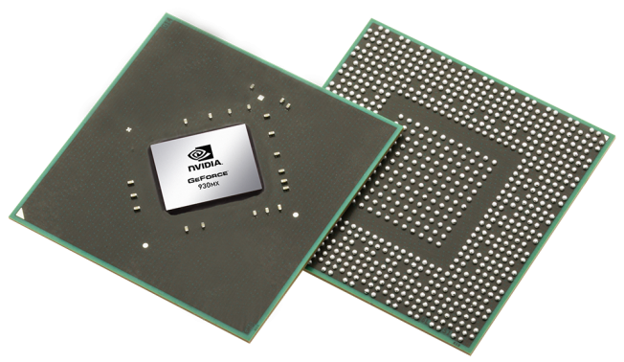
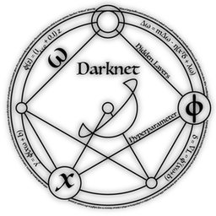
Resources and Technology Considerations
Operating System
Linux Ubuntu 18.04 LTS
Hardware / Firmware
GeForce 930MX Graphics Processing Unit (2GB), Compute Capability: 5.0
CUDA Driver
CUDA 9.0 + cuDNN v7.3.0
Third Party Software
OpenCV 4.0.0
Tensorflow r1.12
Darknet (Framework)
Notes:
Akira

Slide 8
Technology Considerations - Why?
Operating System
Active community of support.
Easy install dependencies via package manager.
Hardware / Firmware
GPU can run thousands of concurrent threads
Exponentially faster training time with GPU vs CPU
Third Party Software
Tensorflow r1.12 will be used for training object detector for Android
Darknet (Framework) server-side object detection
OpenCV - visualize bounding box predictions
Notes:
Akira

Slide 9
Project Plan - Market Survey
Previous Work
Object detection algorithms have been successful for recognizing road damage.
Previous work can detect various road anomalies including alligator cracking, crosswalks, etc.
Previous work utilized semantically segmented methods, bounding box detections, and generative adversarial networks.
Our Proposed Solution
Additionally will detect severity level of each crack
Store GPS location of each crack
Use a combination of object detection on mobile device and server-side (IoT)
.
Figure 1. Proposed Solution
Notes:
Akira Demoss

Slide 10
Project Plan - Risks
Risk Evaluation
Assessment Overview: high risk, high reward project
Risk 1: Lack of Resources
Risk Reduction: Develop early, checkout SSG laptops
Risk 2: Challenging Development Environment
Mitigation: Extensively document installation steps, track issues using GitLab issue tracker.
Risk 3: Lack of Domain Expertise
Mitigation: Do an extensive literature review, implement an agile workflow and be open to design changes
Risk 4: Lack of Resources for server-side detection
Mitigation: Request additional resources from advisor.
Risk | Occurrence | Impact | Exposure
Lack of resources could affect the speed of project progression | 0.05 | Serious | High
Development environment could be too challenging to setup | 0.01 | Critical | High
Lack of domain expertise could lead to solutions that are initially suboptimal | 0.05 | Critical | High
Currently lack the resources to achieve server side severity level detection | 0.1 | Catastrophic | Very High
Table 1. Risk Evaluation
Notes:
Akira Demoss

Slide 11
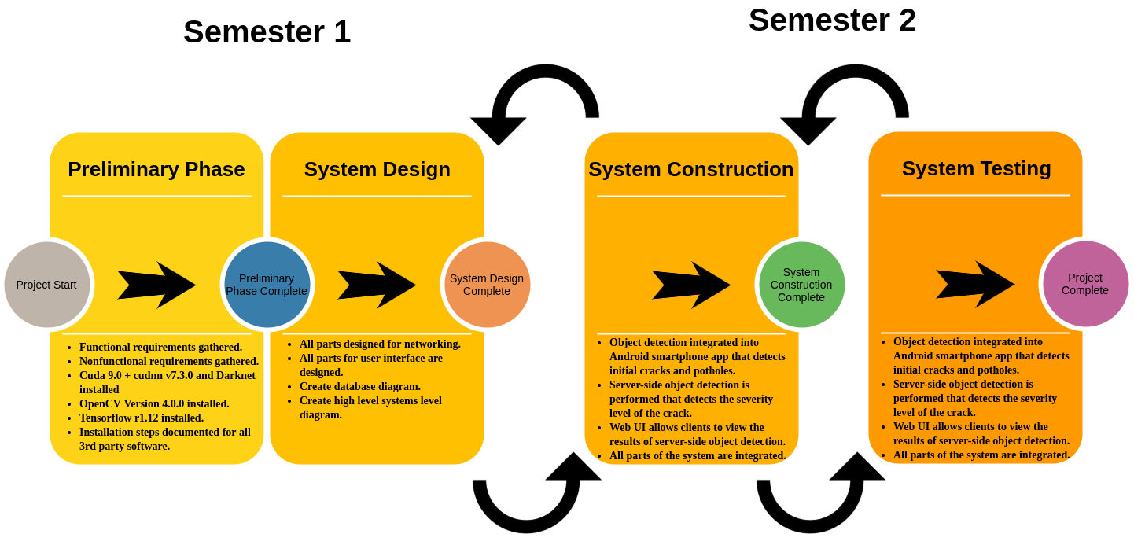
Project Plan - Workflow
Notes:
Akira Demoss

Slide 12
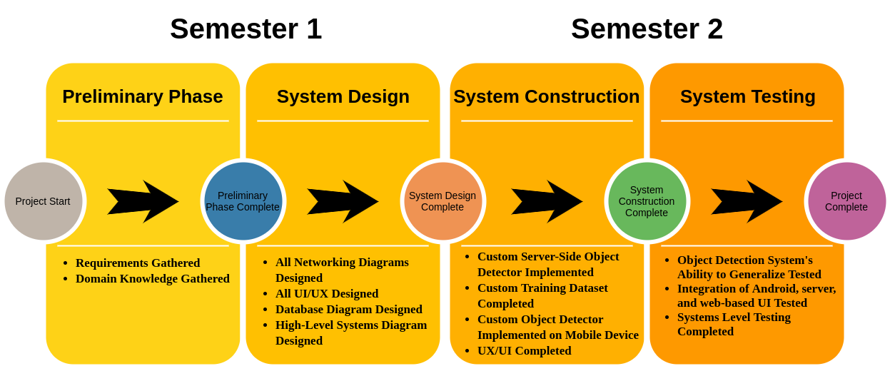
Project Plan - Milestones
Notes:
Akira Demoss

Slide 13
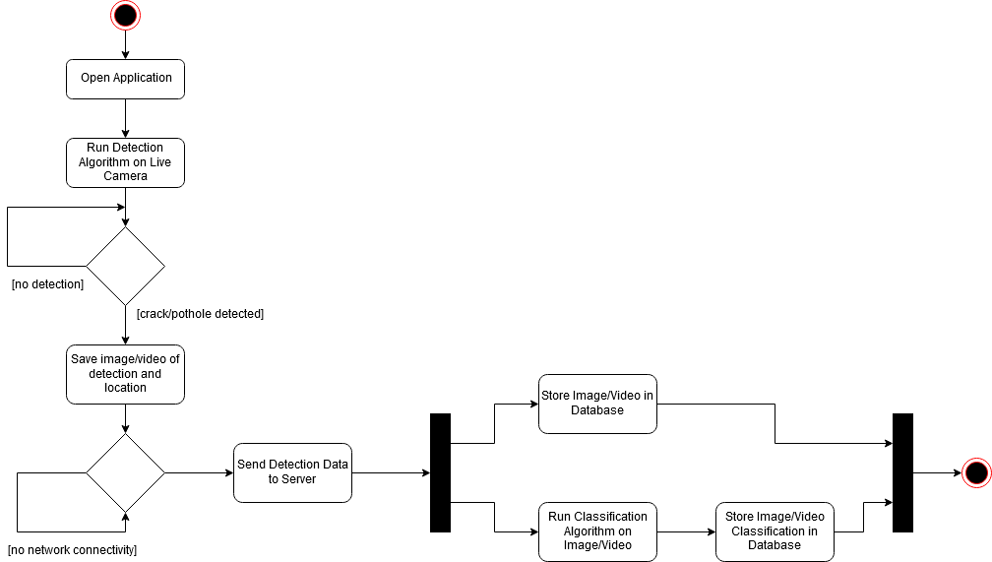
System Design - Overview
Notes:
Nik
Our system is comprised of a mobile interface, which runs the detection algorithms on the love camera. It runs this continuously until a crack or pothole is detected. Once one is identified, it will snap a picture of the crack along with its GPS location and send it to the server. Of course, if there is not network connection, the image will not be able to go through to the server. The snapshot will be run through the classification algorithm and stored alongside its classification.

Slide 14
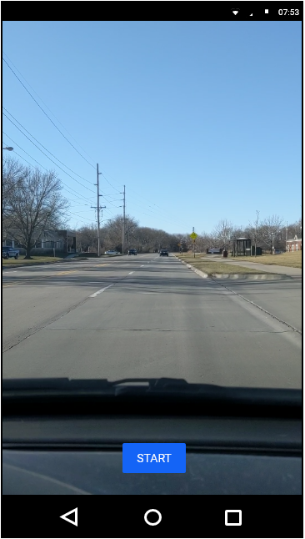
System Design - Android
Use back-camera for recording images/videos
Utilize TensorFlow Lite and NNAPI to make inferences with a trained YOLO model
Send images/videos with Volley library
Get location data with Google location API
Notes:
Maggie

Slide 15
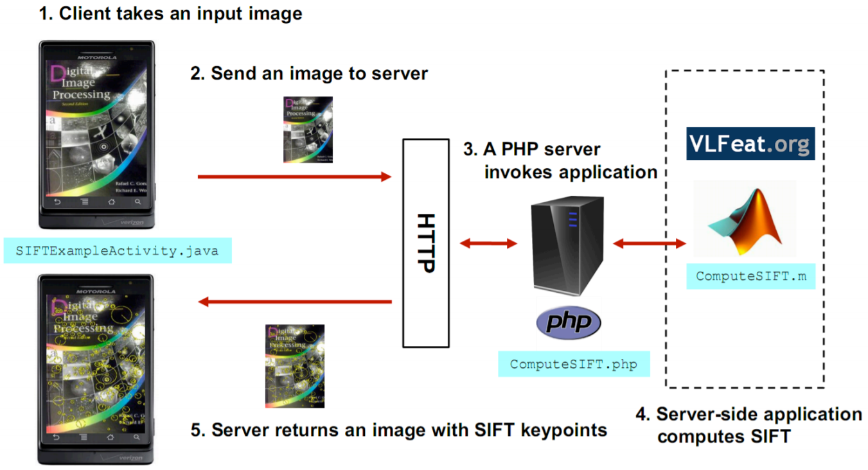
System Design - Server
Notes:
Modeste
Uploading is done using Node.js with Multer and Express (Middleware that enables connection between client and server)
SIFT: Scale-invariant feature transform(Feature-based methods used for image matching)

Slide 16
Prototype Implementation
Figure 2. Ground truth label from image in Japaneese road damage dataset before training YOLOv2 weights and biases.
Figure 3. Bounding box generated from inference
Notes:
Akira Demoss

Slide 17
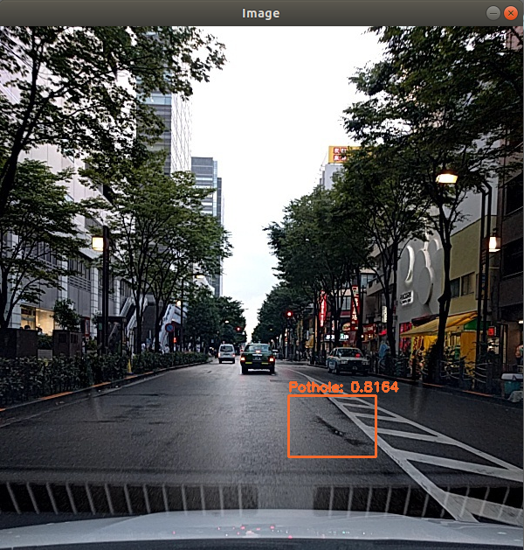
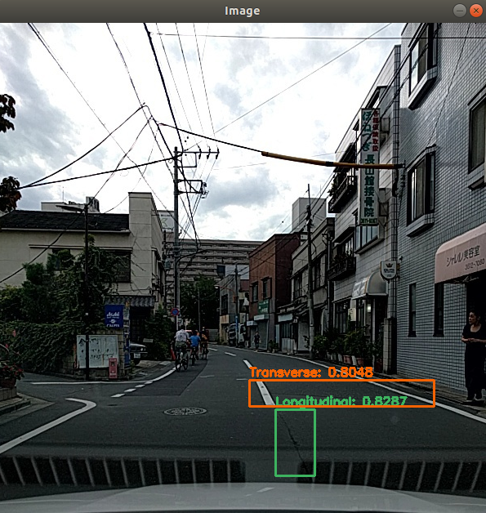
Prototype Implementation
Figure 4. Custom trained YOLOv2-tiny weights and biases detect potholes.
Figure 5. Custom trained YOLOv2-tiny weights and biases detect transverse and longitudinal cracks.
Notes:
Akira Demoss

Slide 18
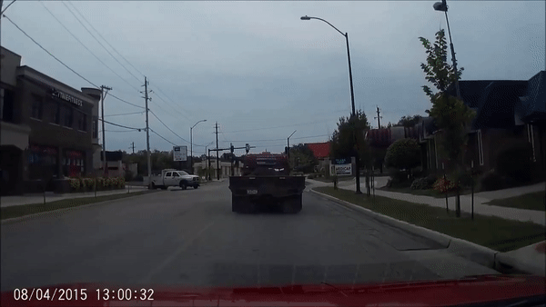
Prototype Implementation - Real Time
Figure 6. Custom Trained YOLOv2-tiny object detection running in real time. Demonstrates the generalizablity of the Japaneese crack detection dataset.
Notes:
Akira Demoss

Slide 19
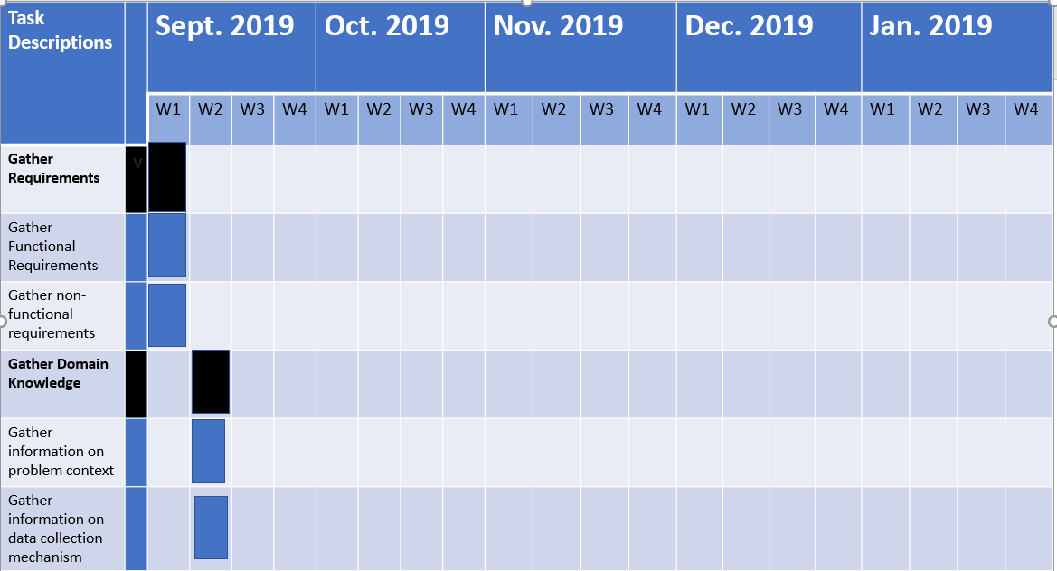
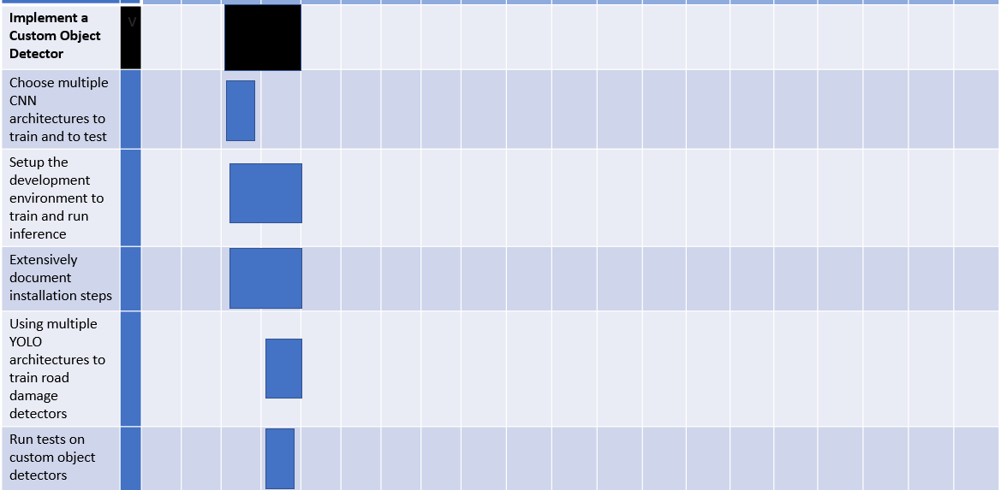
Fall Timeline
Notes:
This is a section of our gantt chart for our timeline of tasks. Following the agile model, the tasks in black are features of the application, and the ones in blue are user stories. For example, gathering requirements is a feature, and gathering functional requirements is a user story.

Slide 20
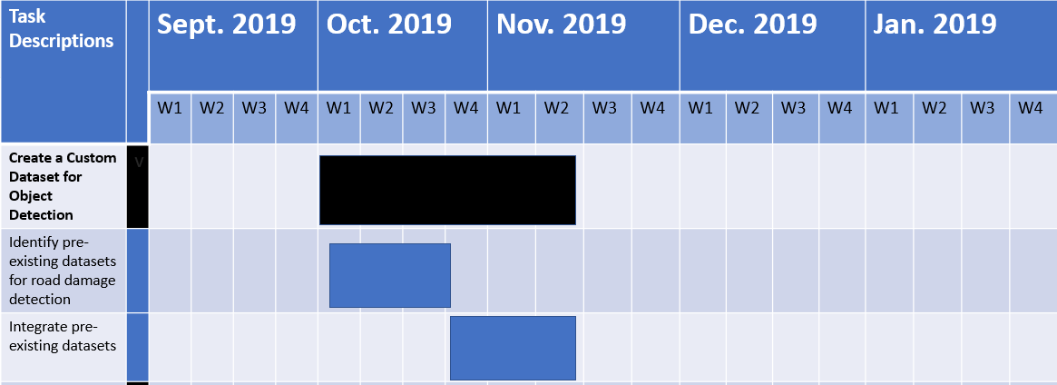
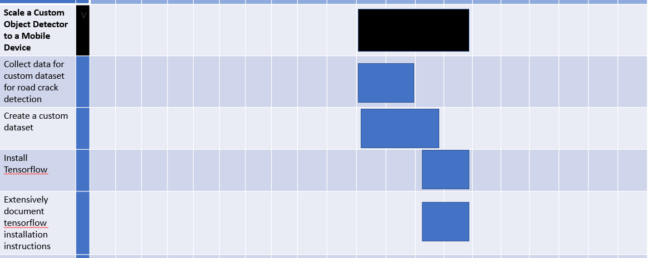
Fall Timeline
(cont.)
Notes:
Here is the rest of our timeline for the fall semester, which includes 2 more features and several user stories.

Slide 21
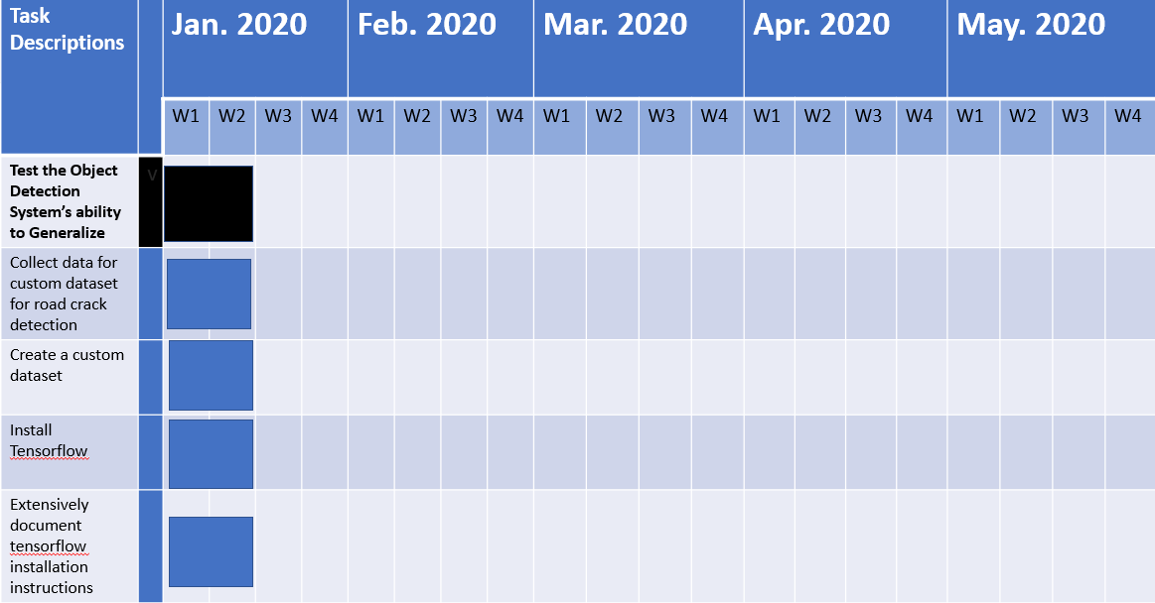
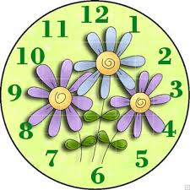
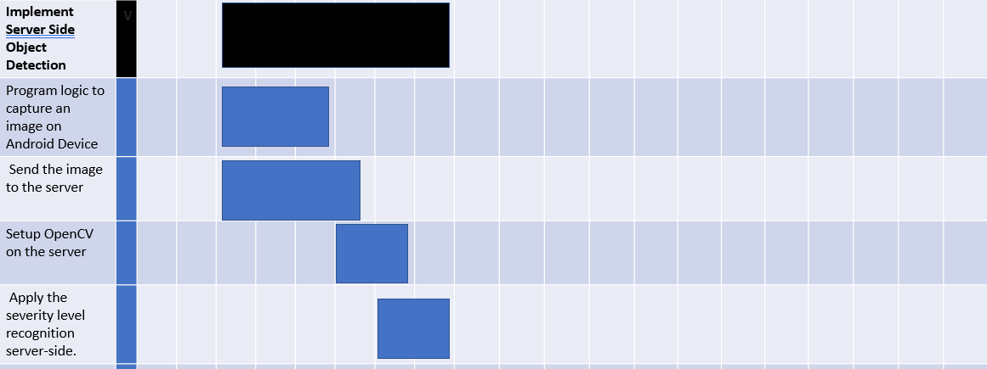
Spring Timeline
Notes:
Here is the first part of our spring timeline, which starts with testing and implementation of server side algorithms.

Slide 22
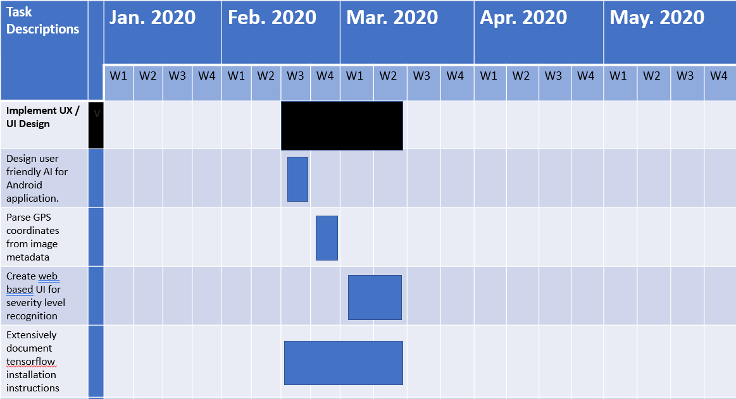
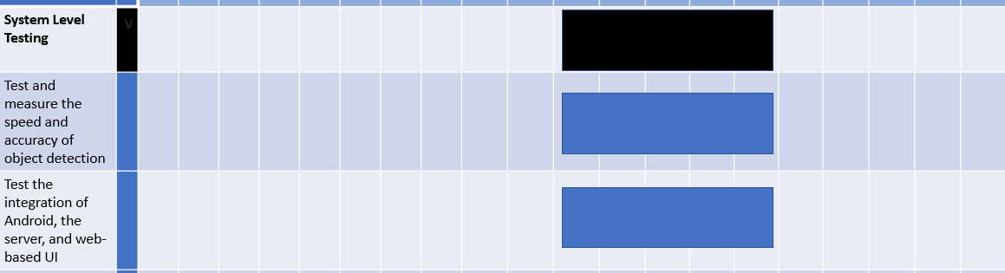
Spring
Timeline
(cont.)
Notes:
Here is the final part of our timeline which includes integrating the UI and finally doing overall system testing on our final product. While creating these tasks, we tried to make the features the larger steps in the project, and break them down into manageable user stories that we could assign to specific weeks in the semester.

Slide 23
How is Testing and Simulation performed?
Put a GPS/Location stamp on images/videos collected on the road
Run algorithm in real-time to detect cracks and potholes
Send snapshots of cracks/potholes to server for a later processing
Ground truth label before training yolo v2 weights
Bounding box generated from inference
Notes:
Modeste
Feeding ~1500 images. Output after ~30 000 iterations

Slide 24
Testing for Overfitting Example
Training Images: 1488
Epochs: 526
Confidence Interval: N/A
Training Images: 1488
Epochs: 789
Confidence Interval: 0.6786
Training Images: 1488
Epochs: 1052
Confidence Interval: 0.6660
Notes:
Modeste
Feeding ~1500 images. Output after ~30 000 iterations

Slide 25
Looking Ahead
What we are done with
Setting up the environment
Researching detection algorithms
Choosing our software and tools
Starting to create our own data set for training
Setting up server
Experimenting with image transmission to and from the server
Trained a model using an existing dataset
Created video examples to test trained model
What needs to be done
Convert Tensorflow model to Tensorflow Lite
Train our detection algorithm with a custom dataset
Develop Android component
Develop web-UI for displaying data
Integrate the UI, server, and algorithm into one functioning application
Research and develop classification algorithm

Slide 26
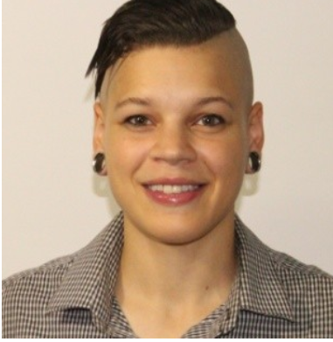
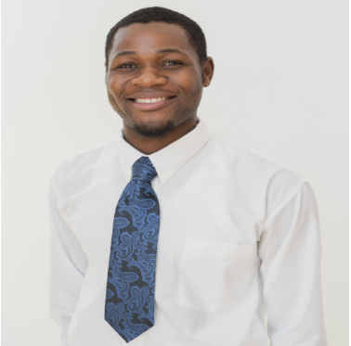
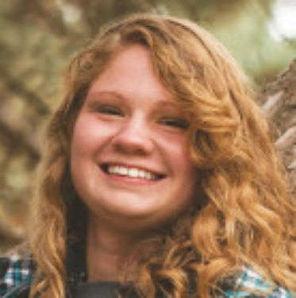
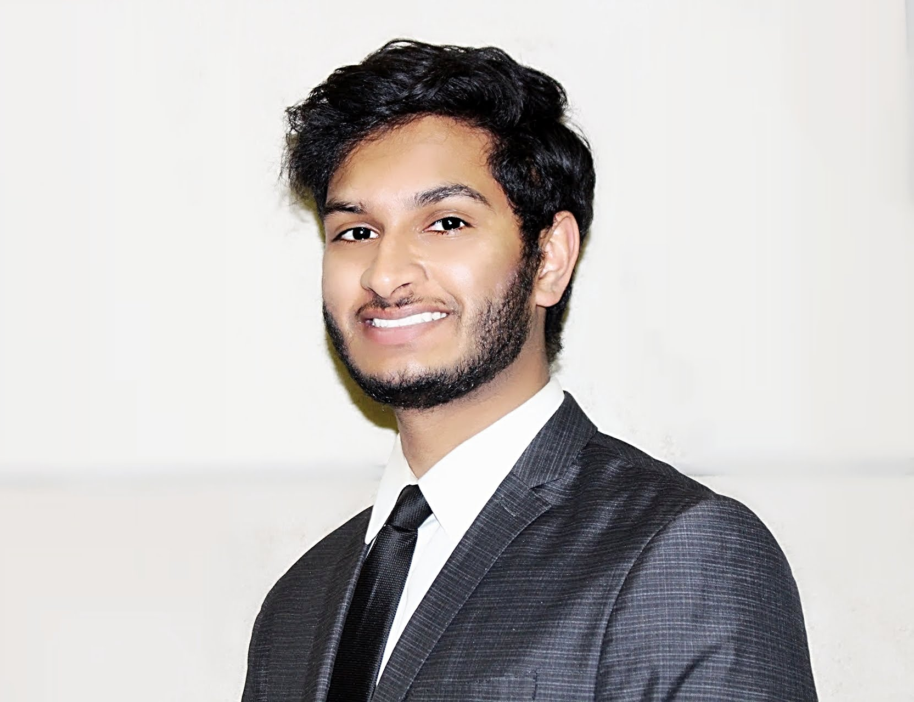
Team Member Contributions
Identified Deep Learning Training Environment
Trained Custom Object Detection Model
Helped identify chosen detection algorithm
Set up training environment
Helped identify chosen detection algorithm
Created prototype videos using trained model
Set up training environment
Created bash script for use in the modifying the data sets.
Set up training environment
Set up node.js modules and require dependencies necessary to compile its native modules
Set up a MongoDB to run our experiments
Created Android Studio project to implement Node.js

